Slide 2
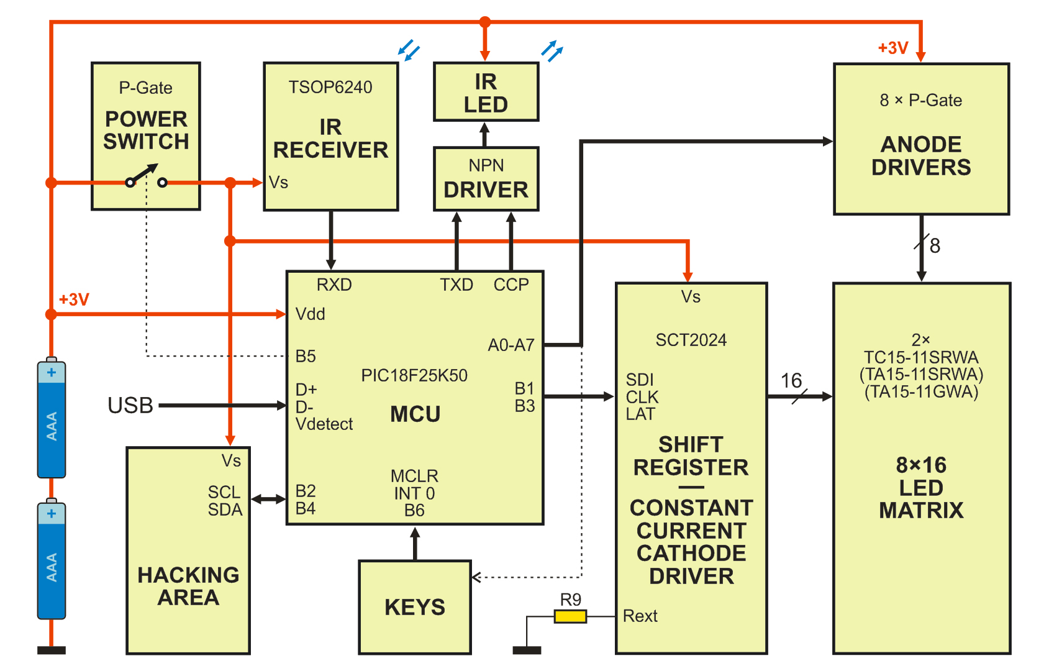

Slide 3
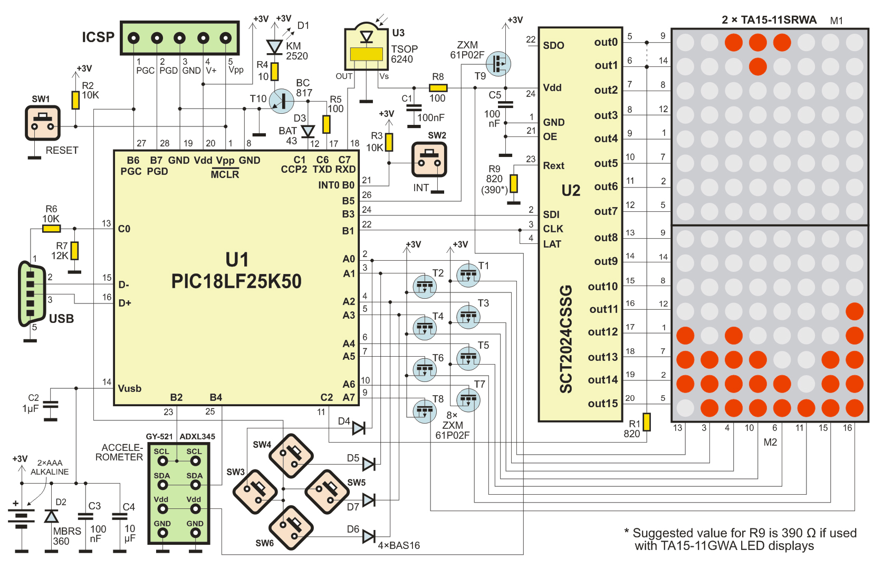

Slide 4
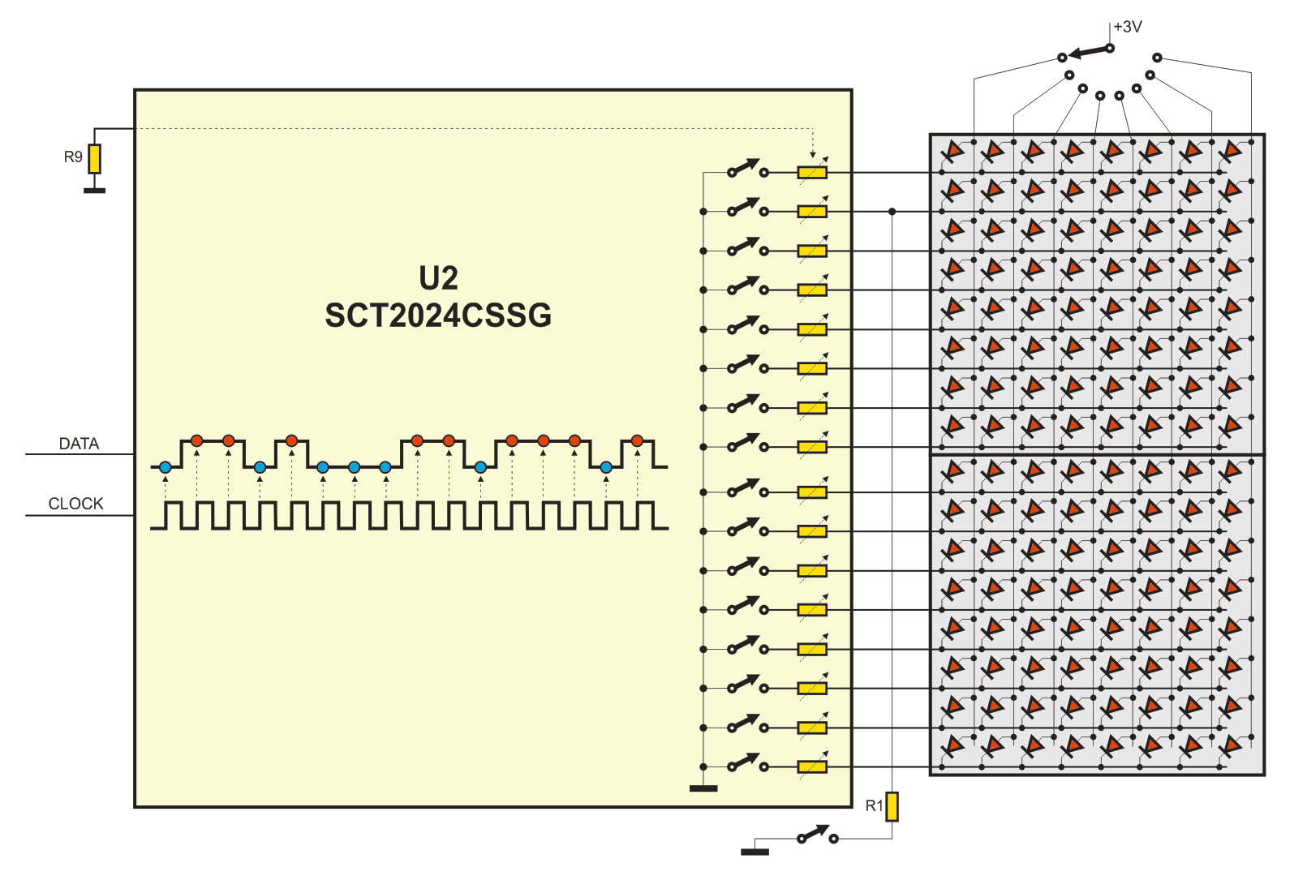
DISPLAY MULTIPLEX

Slide 5
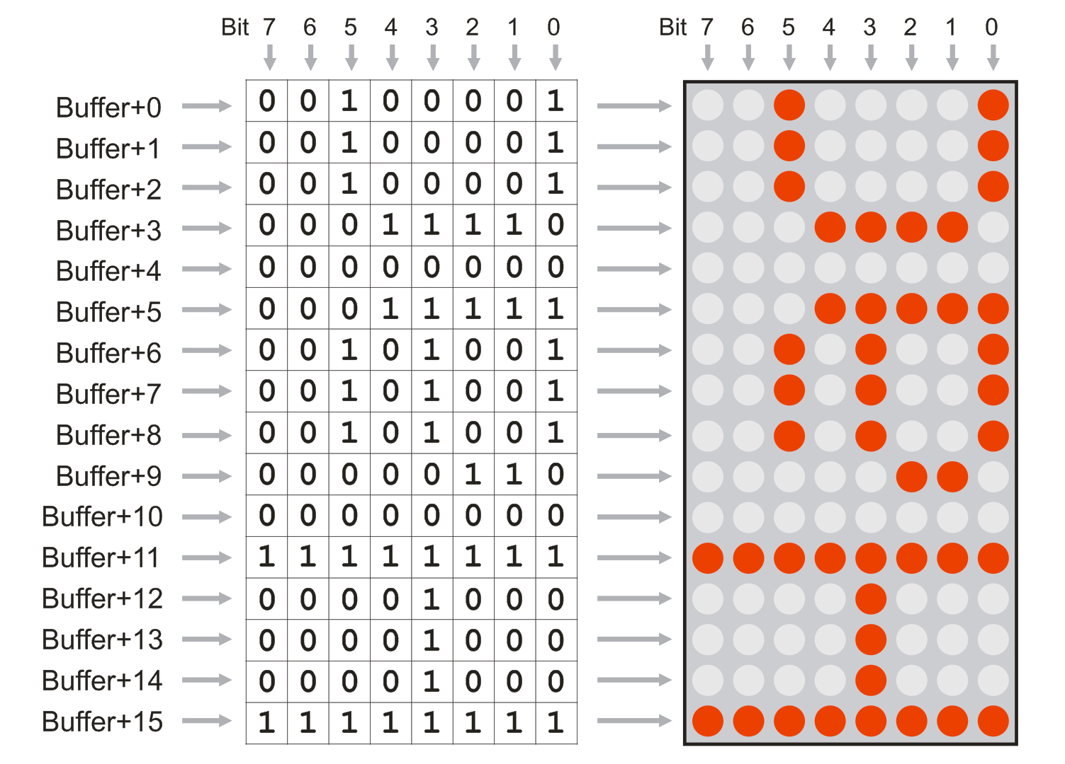
FRAME BUFFER

Slide 6
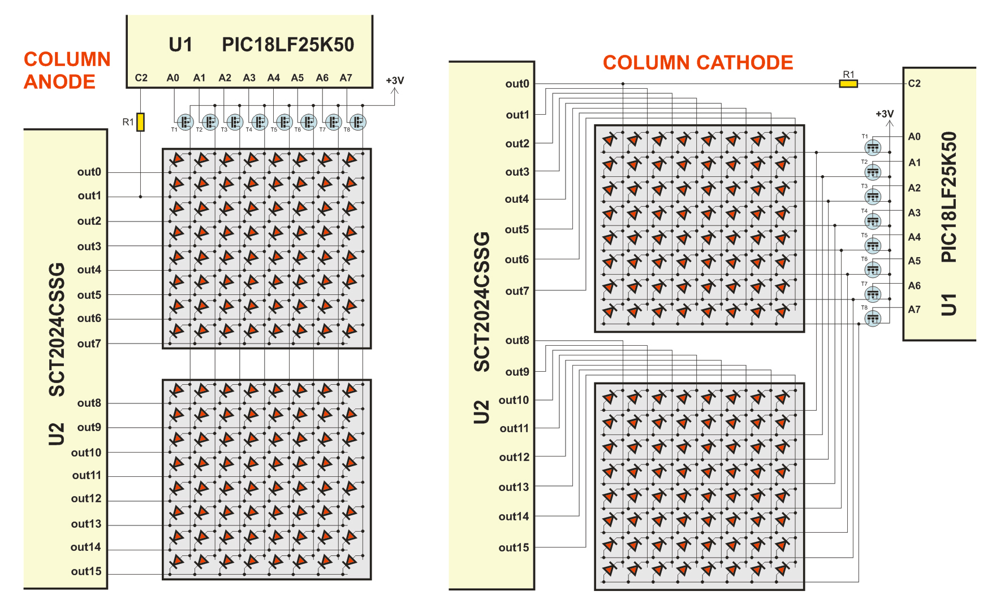
COLUMN ANODE vs. COLUMN CATHODE

Slide 7
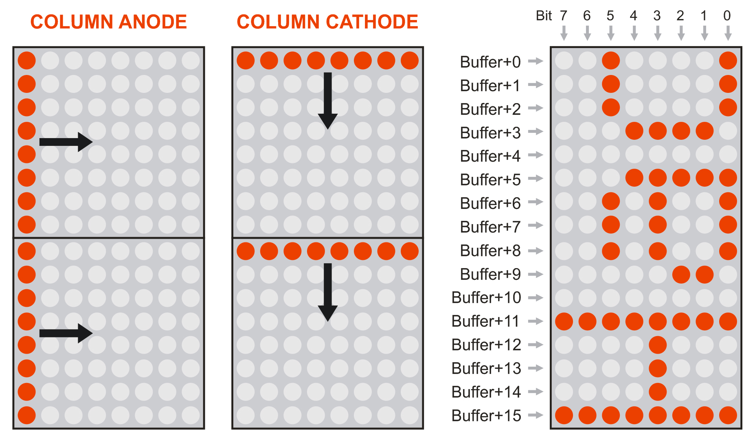
COLUMN ANODE vs. COLUMN CATHODE

Slide 8
COLUMN ANODE vs. COLUMN CATHODE

Slide 9
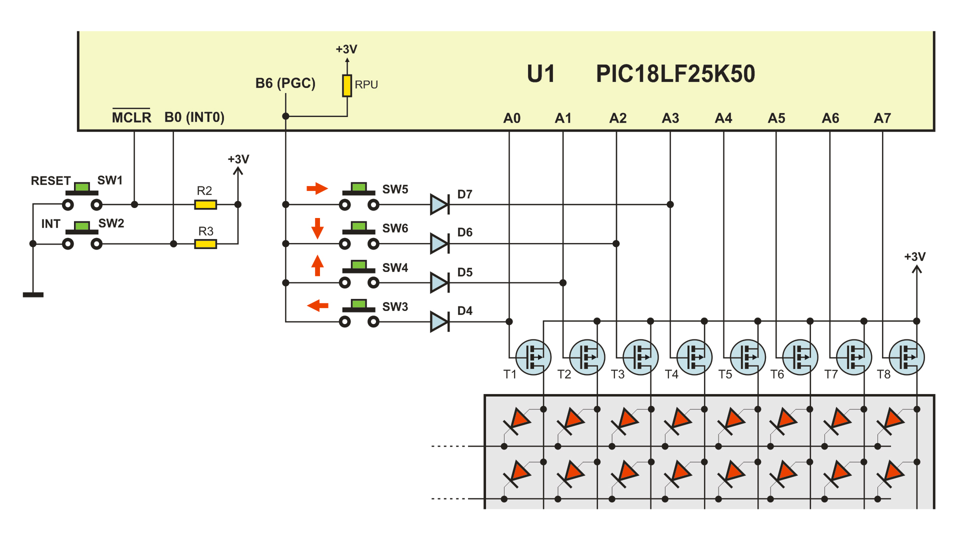
KEY SCAN

Slide 10
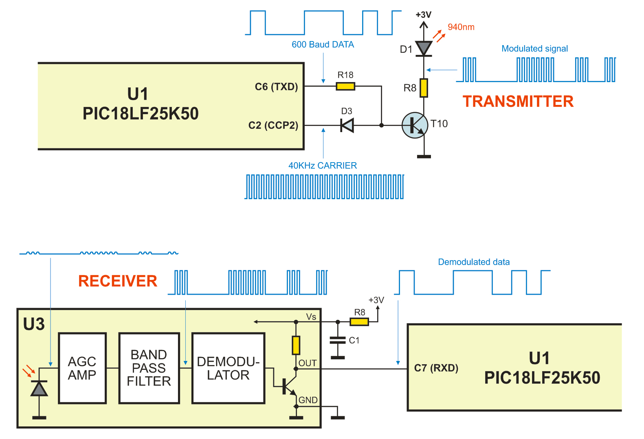
INFRARED TRANSCEIVER

Slide 11
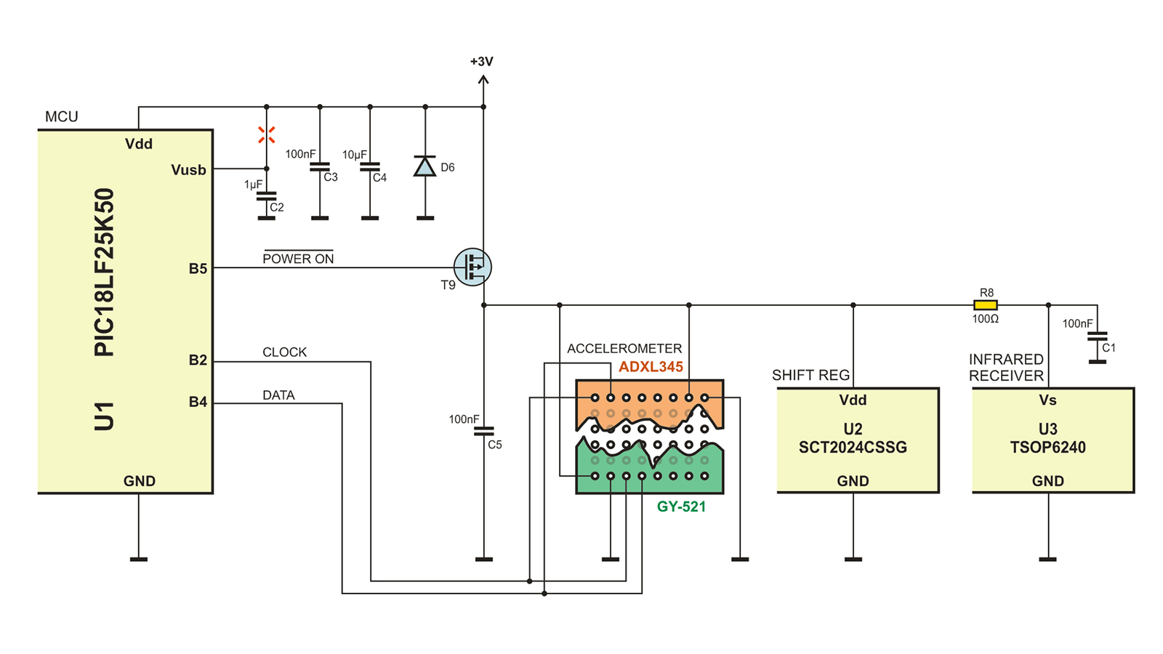
POWER SUPPLY

Slide 12
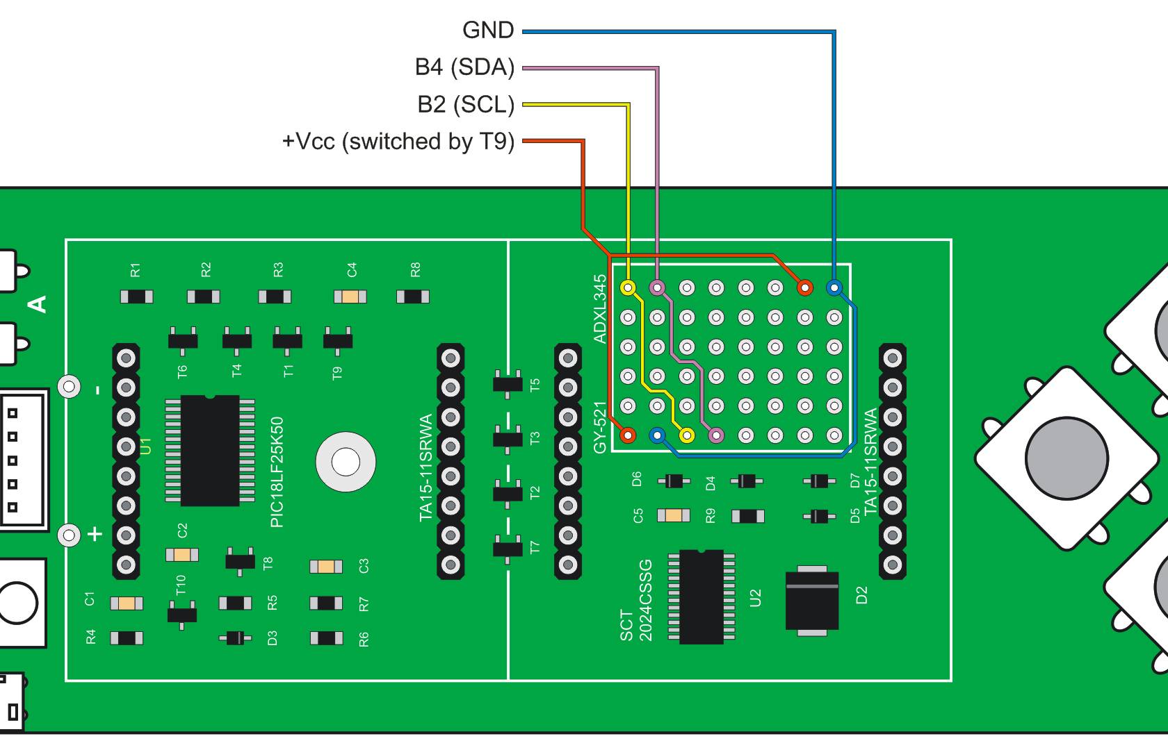
HACKING AREA TERMINALS

Slide 13
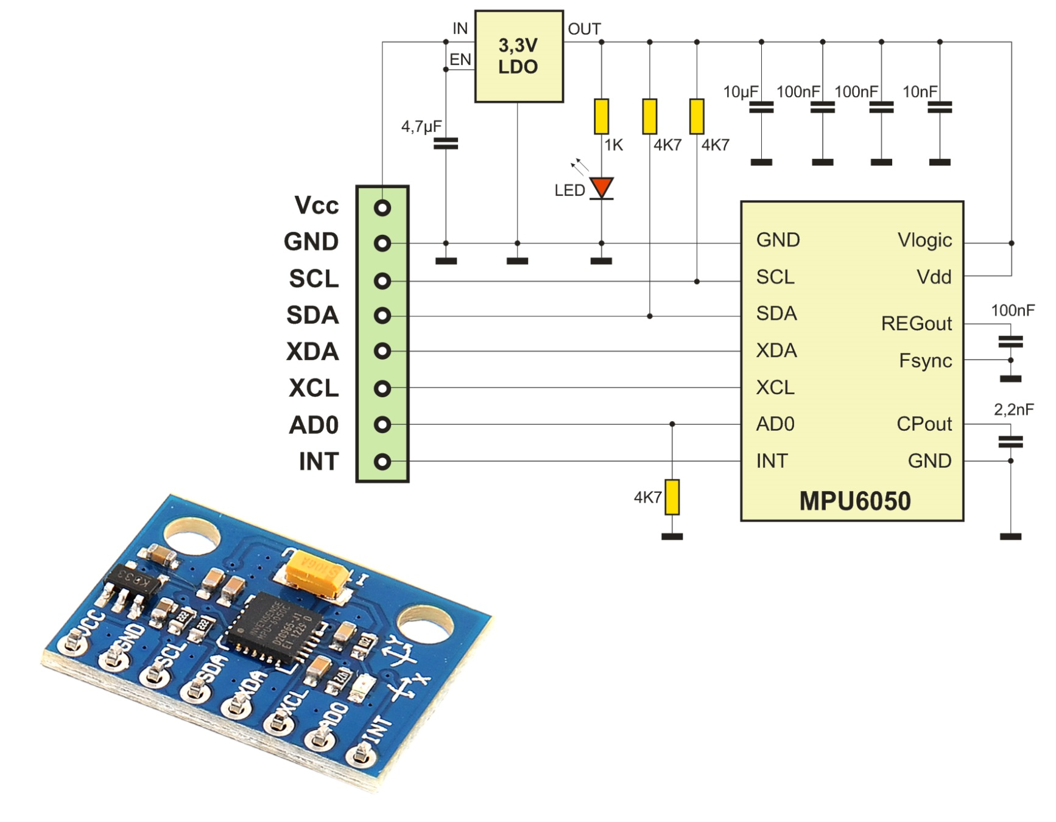
ACCELEROMETER/GYROSCOPE MPU6050

Slide 14
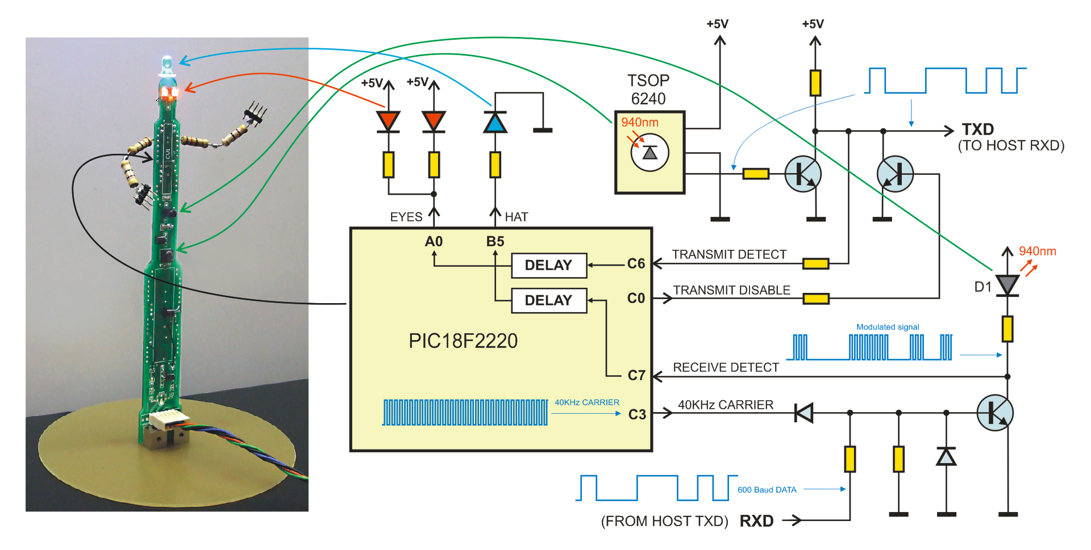
INFRARED TERMINAL

Slide 15
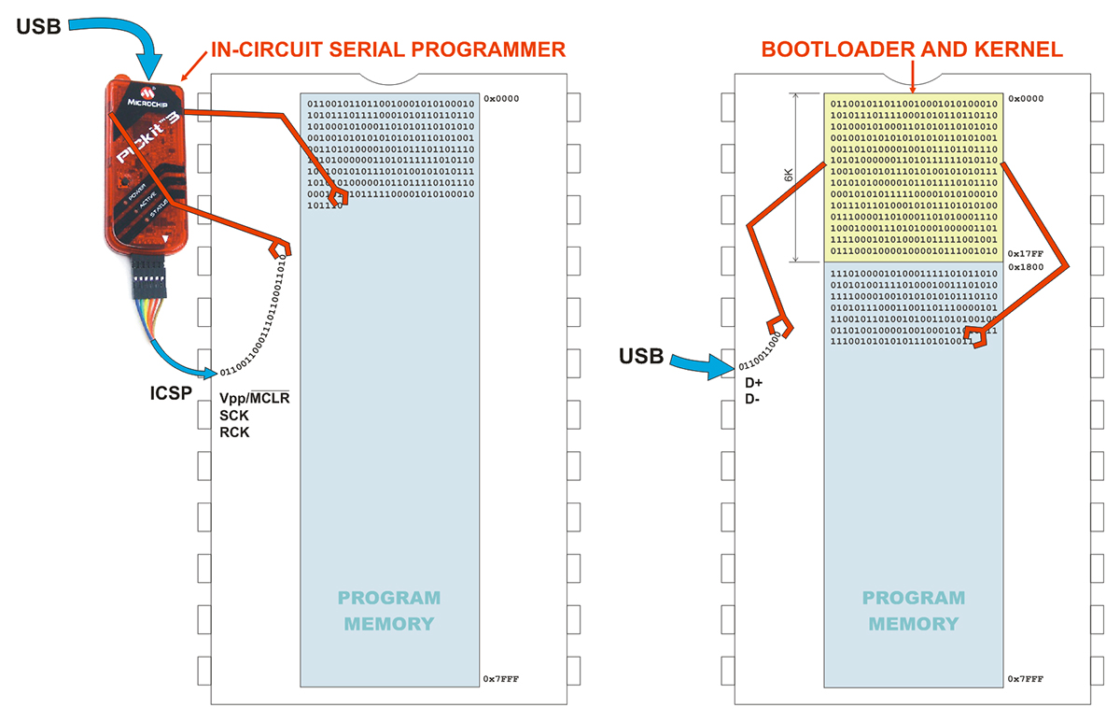
IN-CIRCUIT SERIAL PROGRAMMER vs. BOOTLOADER

Slide 16
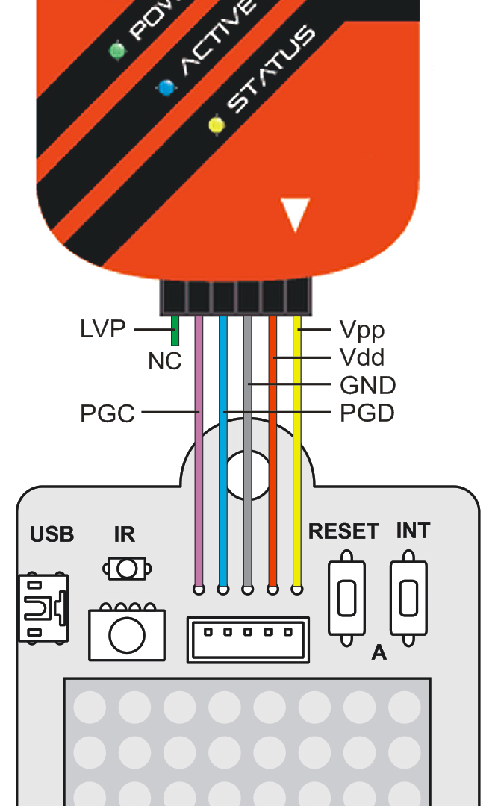
PICKIT 3 CONNECTING

Slide 17
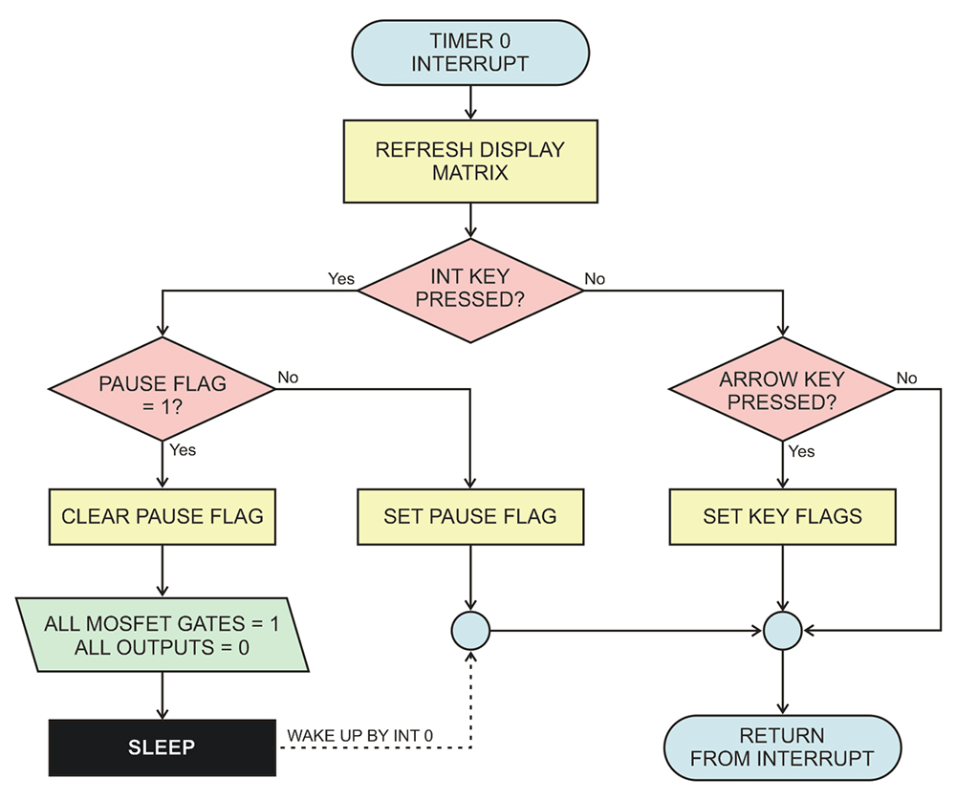
TIMER 0 INTERRUPT

Slide 18
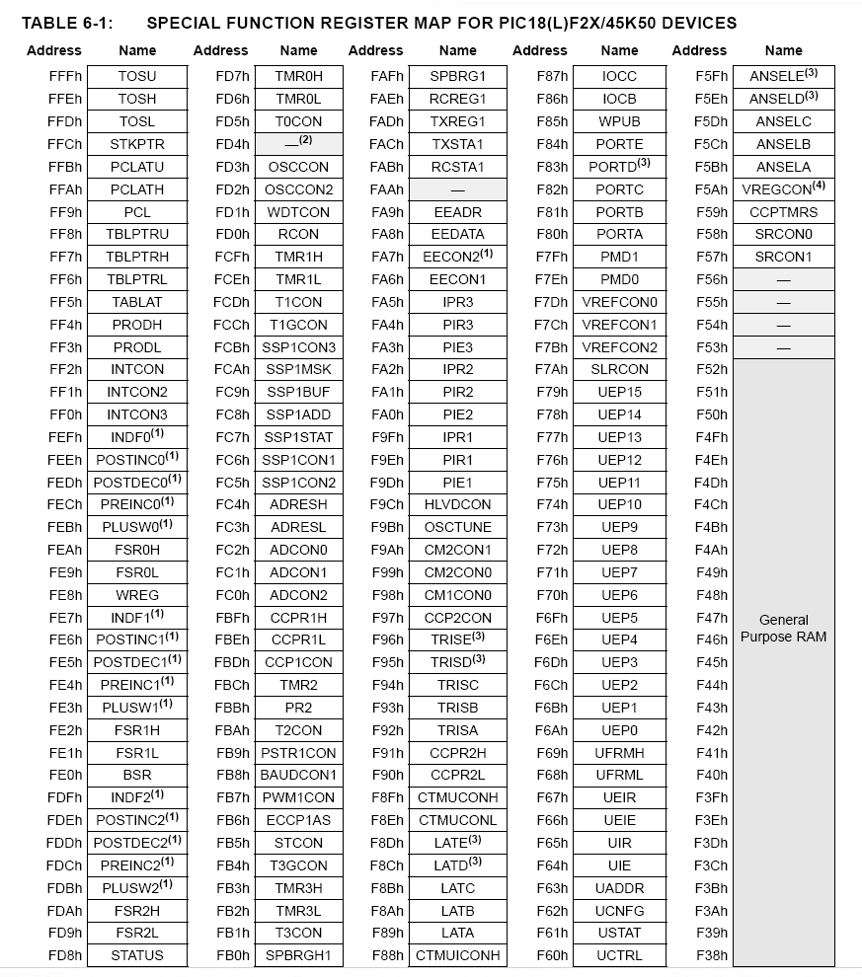
Addressing ANSELx SFR

Slide 19
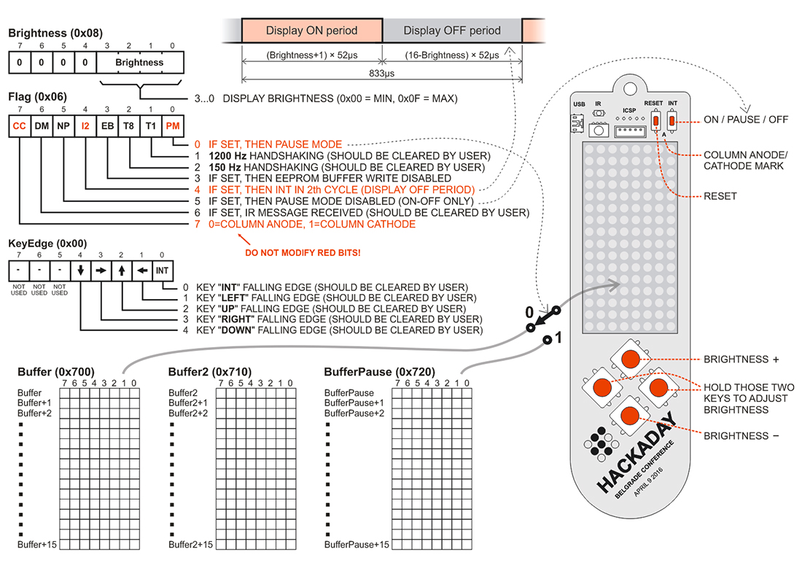
GP REGISTERS AND KEY FUNCTIONS

Slide 20
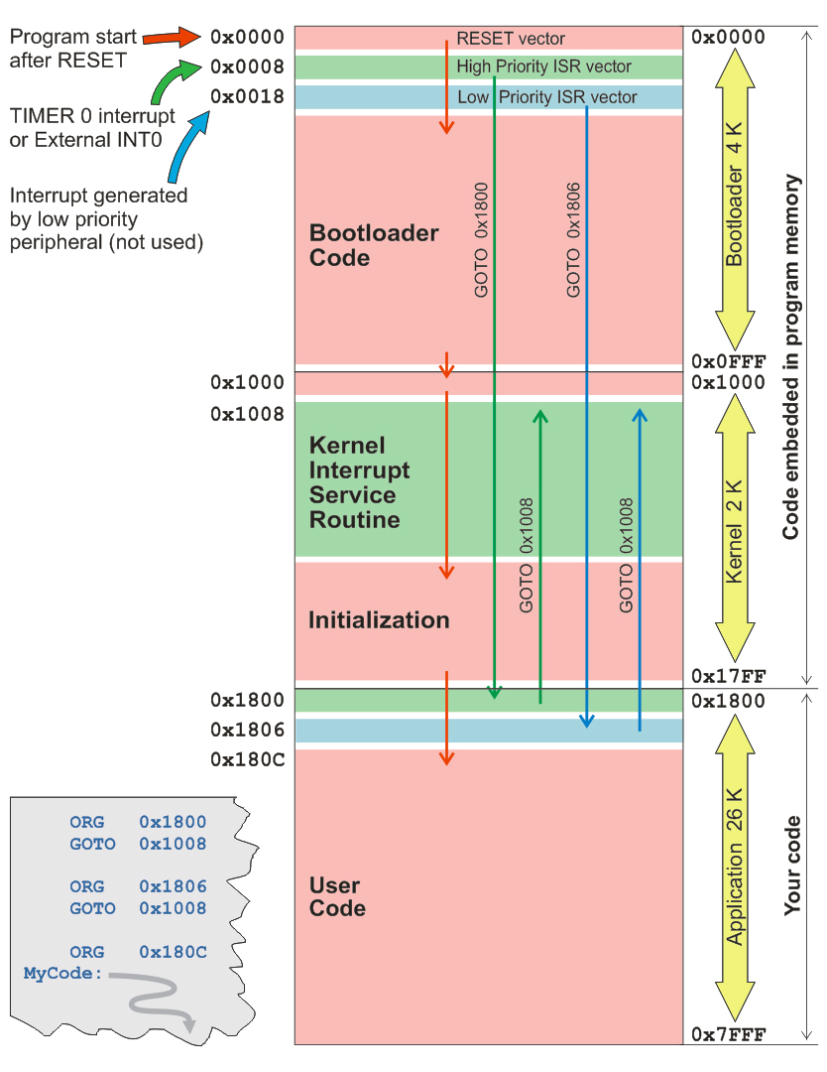
PROGRAM FLOW

